Slide 1
Intelligent Navigation and Obstacle Avoidance for Autonomous Systems
Team Members:
Venkata Srimannarayana Yasam
Bindu Sri Manne
Vishnu Vardhan Reddy Kunduru

Slide 2
Introduction & Problem Definition
Purpose: We aim to develop a fully autonomous system that can navigate through complex, changing environments without human control. Our system must think, adapt, and act independently.
Challenges:
Perception: Robots struggle with noisy and incomplete sensor data.
Planning: Robots must quickly adjust paths when obstacles appear.
Control: Robots must move stably across different terrains, avoiding jerky or unsafe motions.
Goal: Create an AI-powered solution that allows robots to perceive, plan, and control actions reliably even in unpredictable real-world conditions.

Slide 3
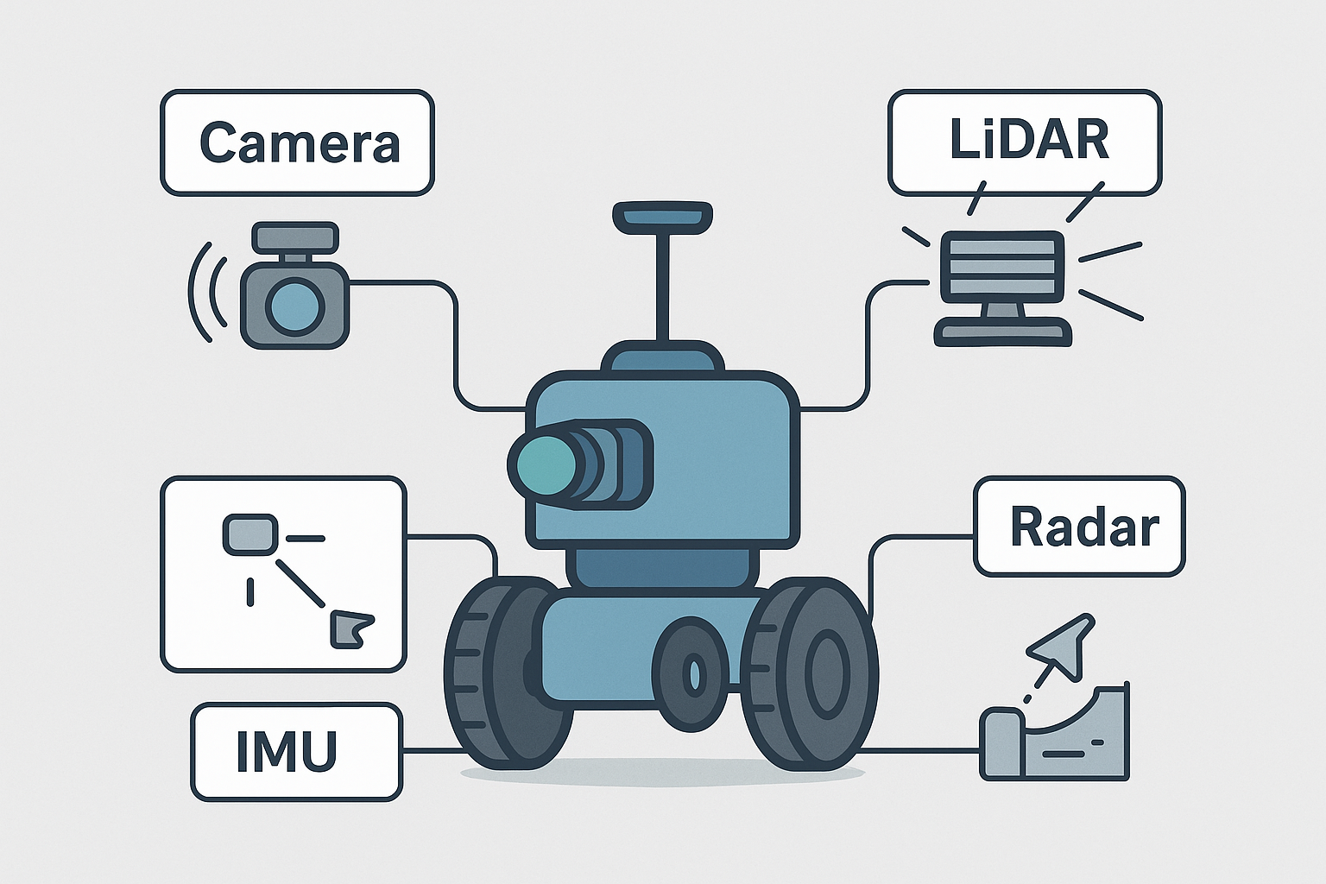
Perception Challenges
Sensors Used:
Cameras: Visual interpretation.
LiDAR: Distance measurement.
Radar: Object detection through obstacles.
IMUs: Measure motion and orientation.
Issues:
Sensors provide incomplete, noisy, or distorted data.
Lighting, rain, fog can severely impact sensor performance.
Solution: We use sensor fusion techniques, combining the strengths of each sensor, to create a reliable view of the environment.

Slide 4
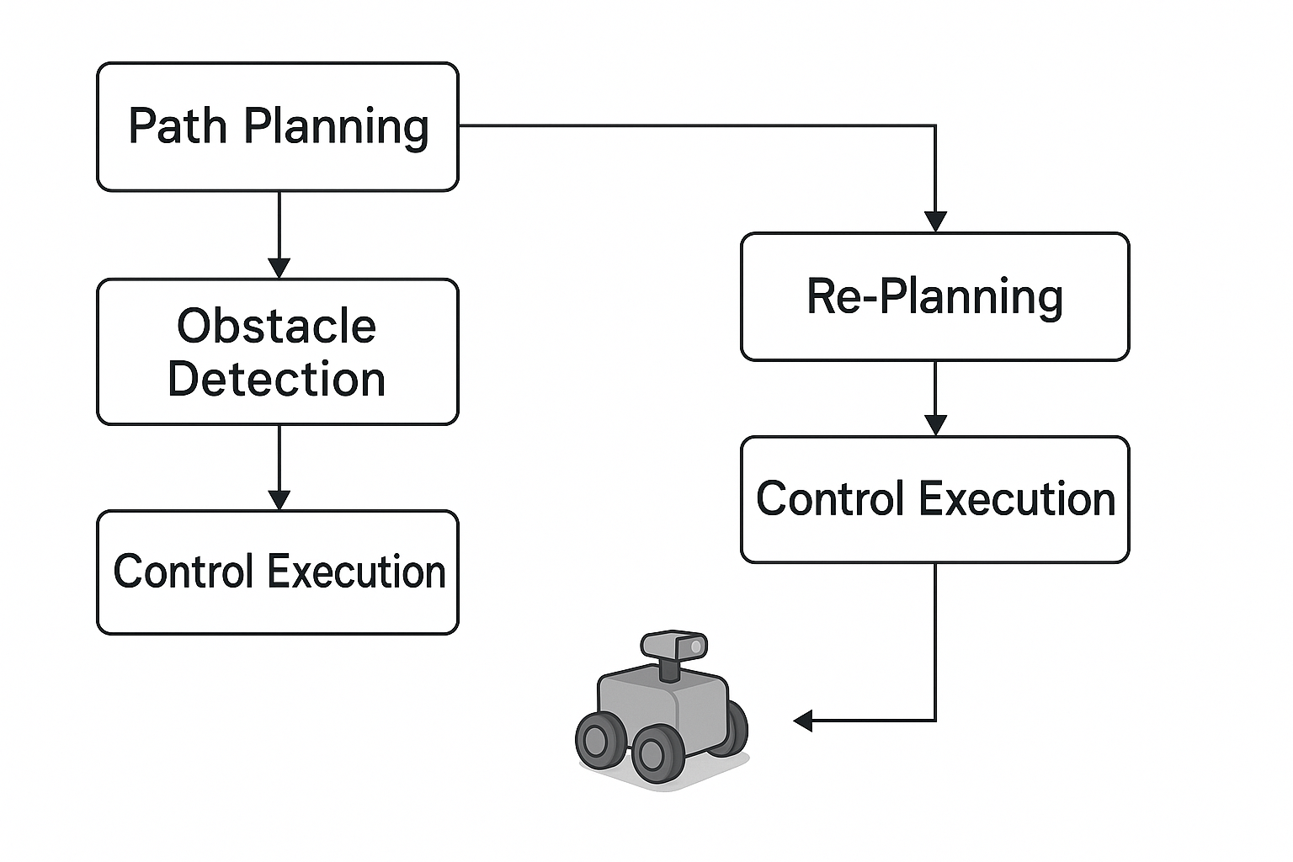
Planning and Control Challenges
Path Planning: Robots must plan efficient paths while dynamically responding to moving obstacles like people, vehicles, or animals.
Control: Precise control is needed to smoothly navigate varying terrains and adjust for forces like friction or slippage.
Solution: We integrate real-time re-planning algorithms with reinforcement learning-based control to maintain safe and adaptive motion.

Slide 5
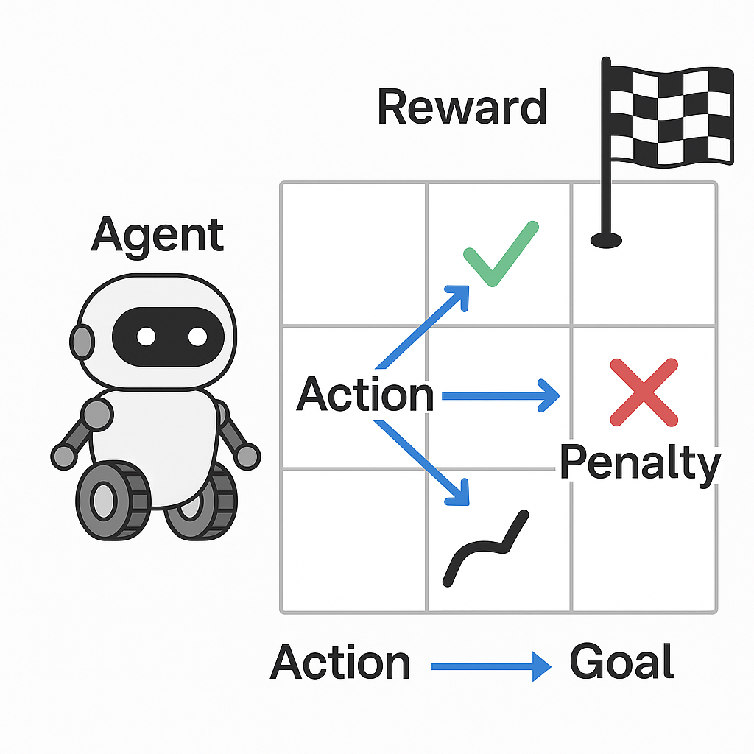
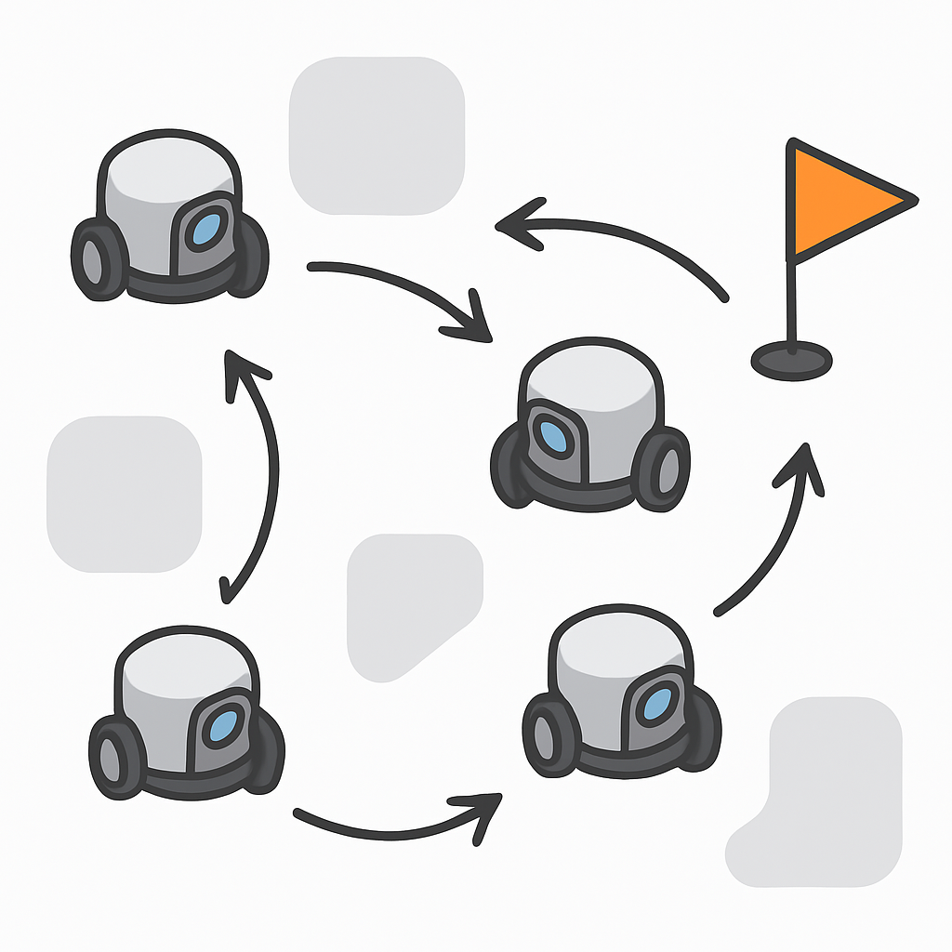
AI Methods Overview
Deep Reinforcement Learning (DRL): We train the robot by rewarding good navigation
actions and penalizing mistakes, allowing it to
learn safe strategies over time.
Path Planning Algorithms: We use classic algorithms like A*, Dijkstra, and sampling-based RRT,
then enhance them with AI to make planning faster and smarter.
Multi-Agent Coordination: For scenarios with multiple robots, we design decentralized
coordination techniques inspired by swarm intelligence to
avoid collisions and work collaboratively.

Slide 6
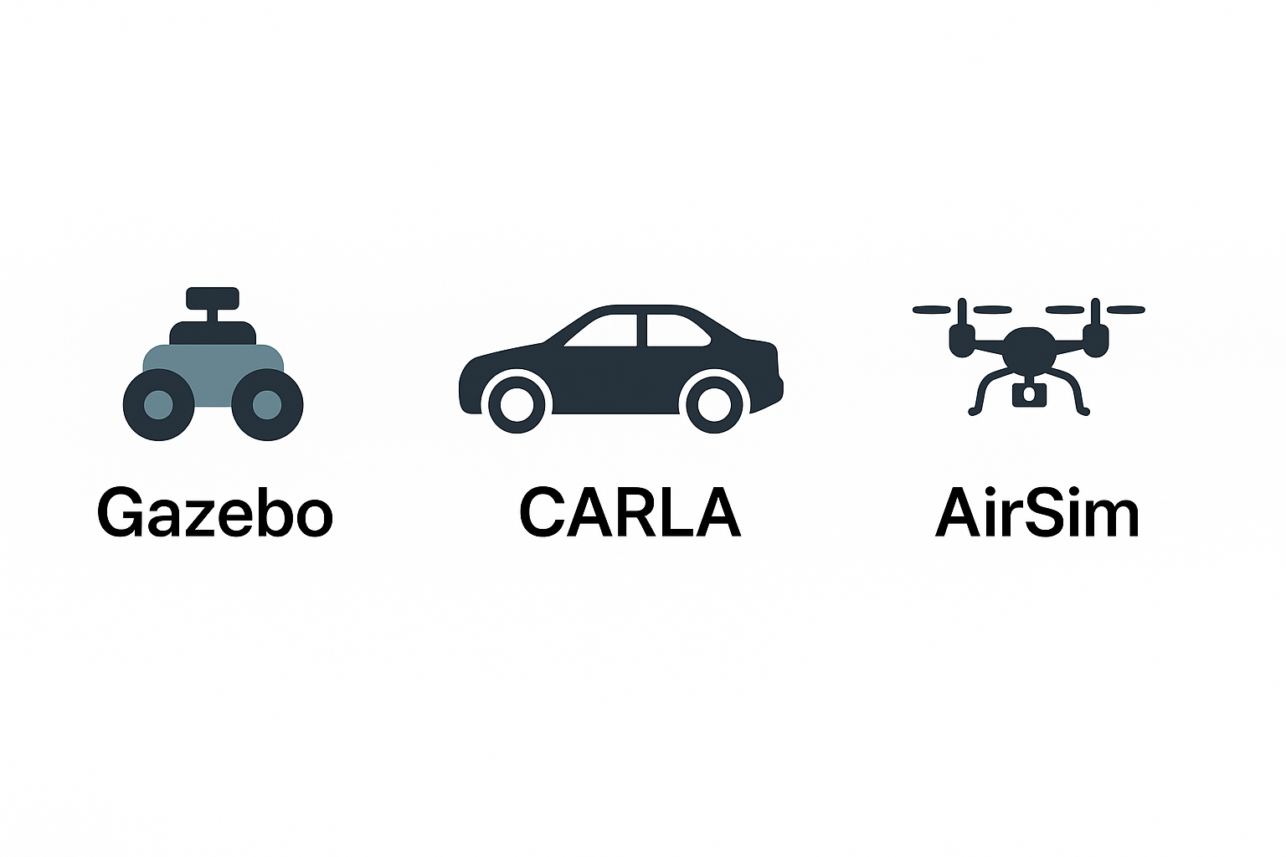
Simulation Setup
Tools:
Gazebo: Simulates ground robots in urban and off-road settings.
CARLA: Simulates autonomous cars in realistic traffic scenarios.
AirSim: Simulates aerial drones in outdoor environments.
Conditions Simulated: We test robots under various weather conditions like rain, fog, and poor lighting, with static and moving obstacles.

Slide 7
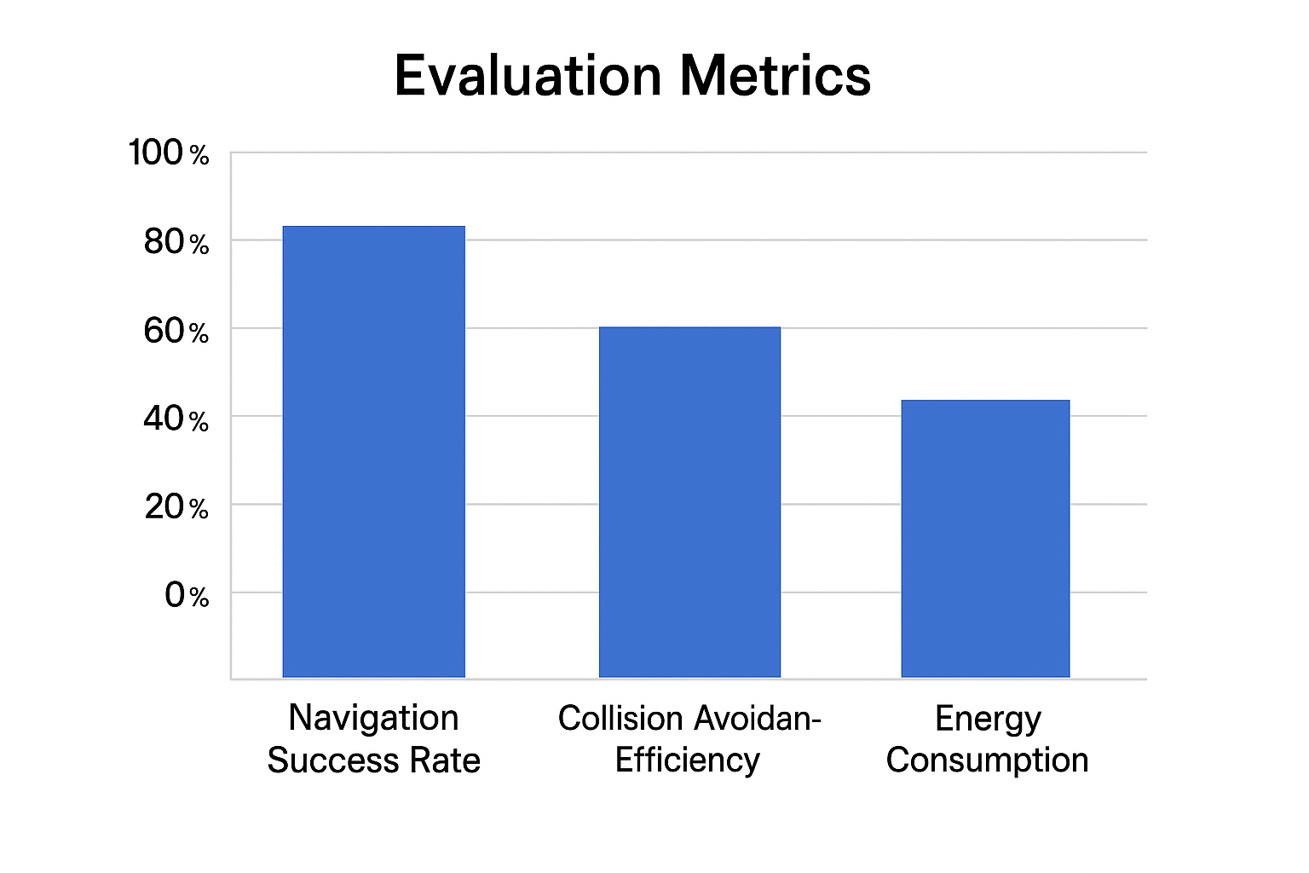
Experimental Design & Metrics
Training Setup: Robots are trained using closed-loop reinforcement learning where they learn by trial and error in diverse environments.
Evaluation Metrics:
Navigation Success Rate: % of missions completed without failure.
Collision Avoidance Efficiency: How rarely the robot hits obstacles.
Energy Consumption: How efficiently the robot uses its battery.
Adaptive Learning Rate: How quickly it learns and adapts in new conditions.

Slide 8
Expected Results
Anticipated Outcomes:
Smarter, faster real-time adaptation to new environments.
Better obstacle avoidance compared to traditional rule-based systems.
Efficient energy usage leading to longer mission times.
Impact: Safer, more reliable robots capable of operating independently in the real world.

Slide 9
Challenges and Mitigations
High Computational Load: AI models are pruned and optimized to run on edge devices like onboard computers without needing cloud computation.
Sensor Noise: We apply Bayesian filtering and probabilistic data fusion to filter out bad readings and improve reliability.
Generalization to New Environments: We use transfer learning and domain adaptation so that robots trained in simulation can adapt quickly to real-world differences.

Slide 10
Conclusion & Future Work
Summary: Our project successfully demonstrated that integrating AI techniques, such as Deep Reinforcement Learning and adaptive path planning, can significantly improve autonomous robot navigation in dynamic environments. Simulations using Gazebo, CARLA, and AirSim validated improvements in navigation success, collision avoidance, and energy efficiency.
Future Work: Moving forward, we aim to deploy the trained models onto real-world robots and drones, enhancing system robustness through advanced sensor fusion techniques like 3D LiDAR. We also plan to extend the framework to support decentralized multi-robot coordination in real-world applications.

